Slide 1
6371 QQQ
By Rashmi patel

Slide 2
UNIT 9 QQQ

Slide 3
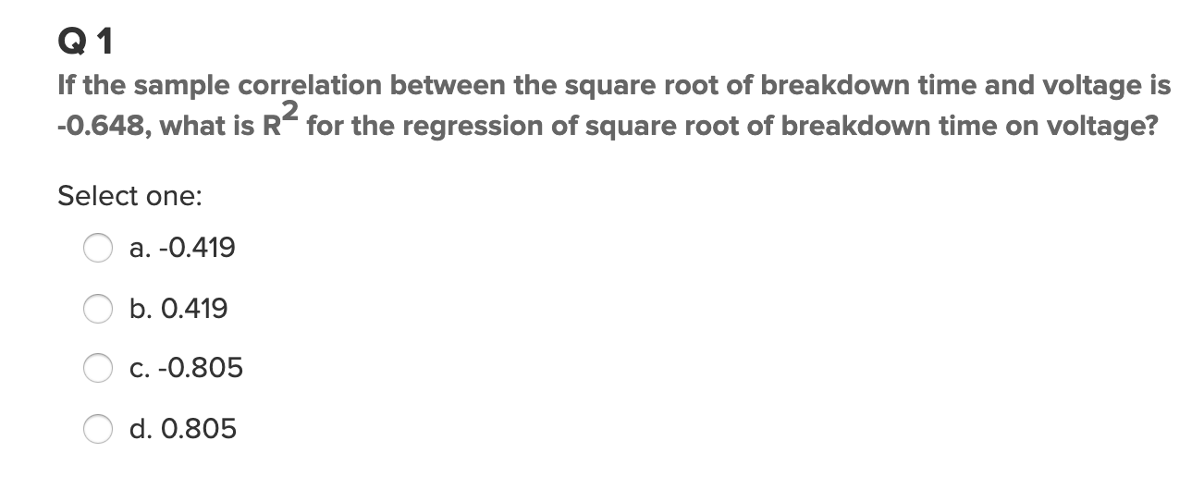
Option b

Slide 4
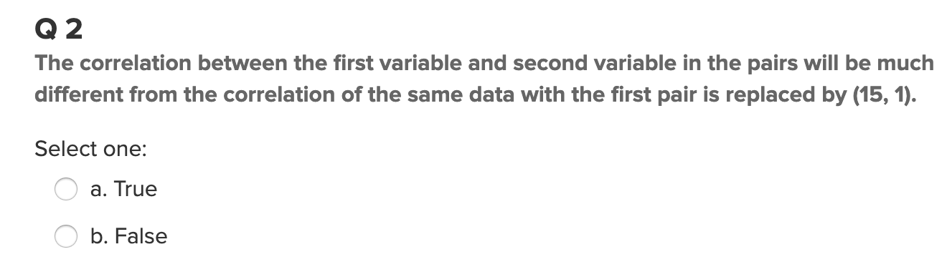
Option: False

Slide 5
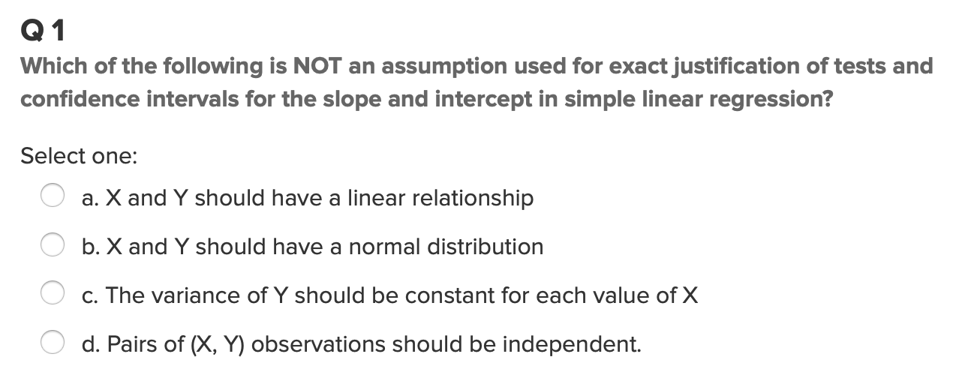
Option D

Slide 6
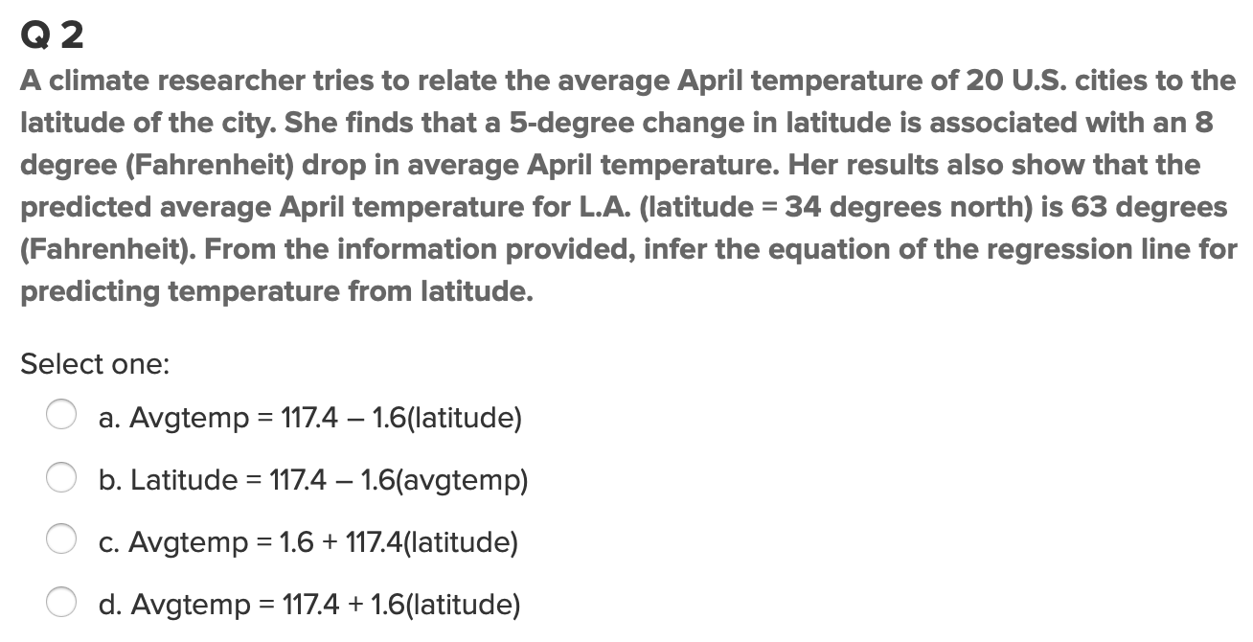
Option A

Slide 7
UNIT 10 QQQ

Slide 8
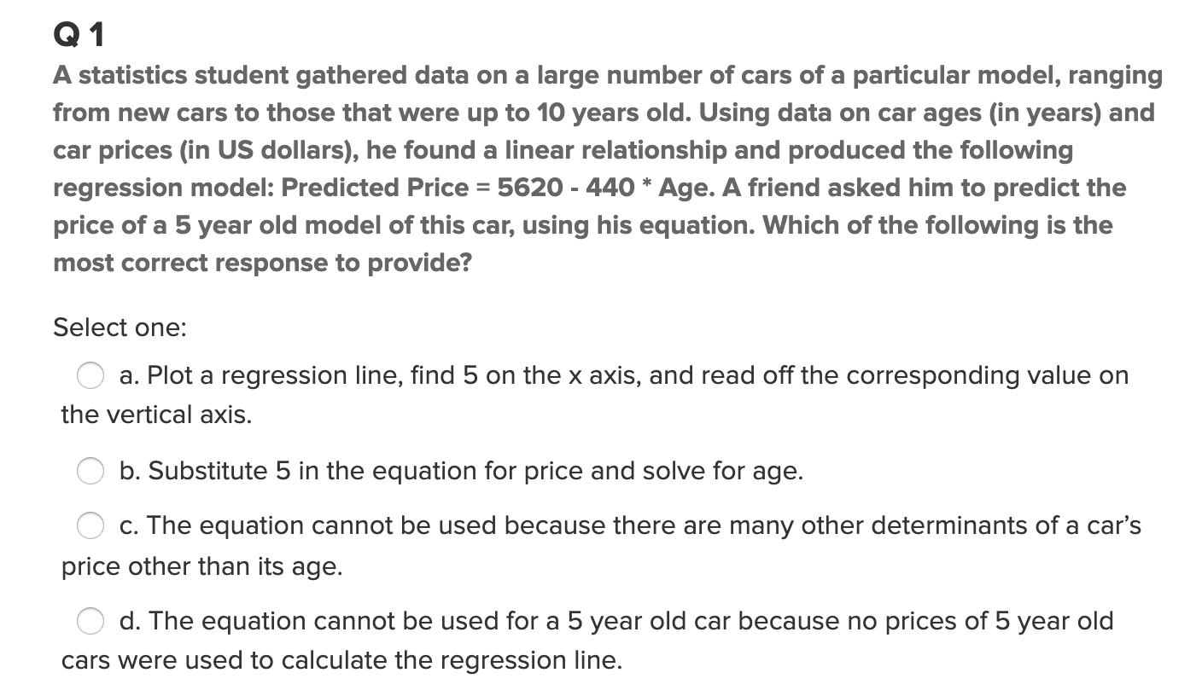
Option A

Slide 9
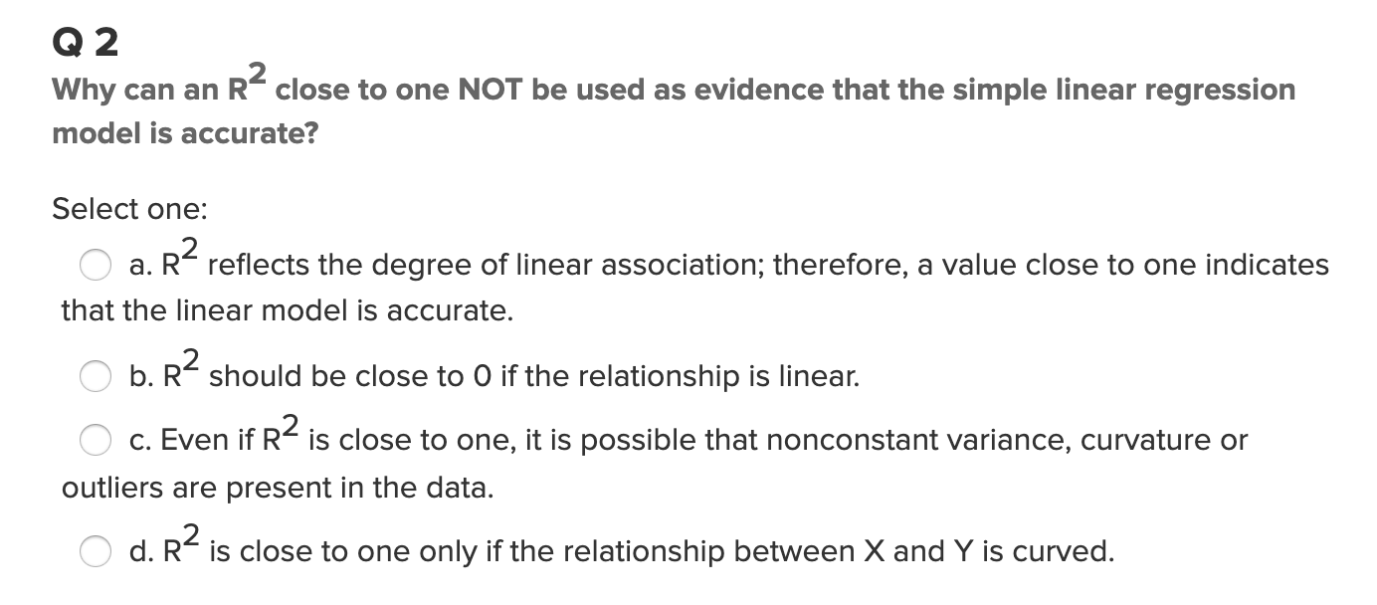
Option C

Slide 10
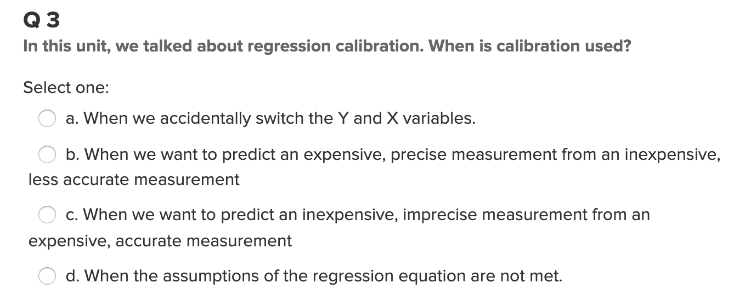
Option C

Slide 11
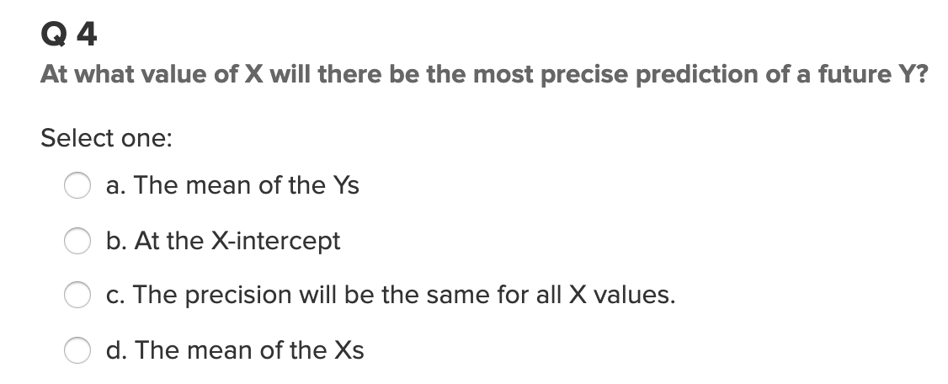
Option A

Slide 12
UNIT 11 QQQ

Slide 13
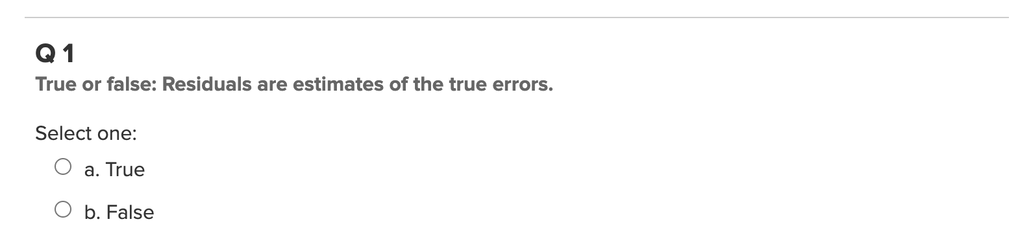
Option A

Slide 14
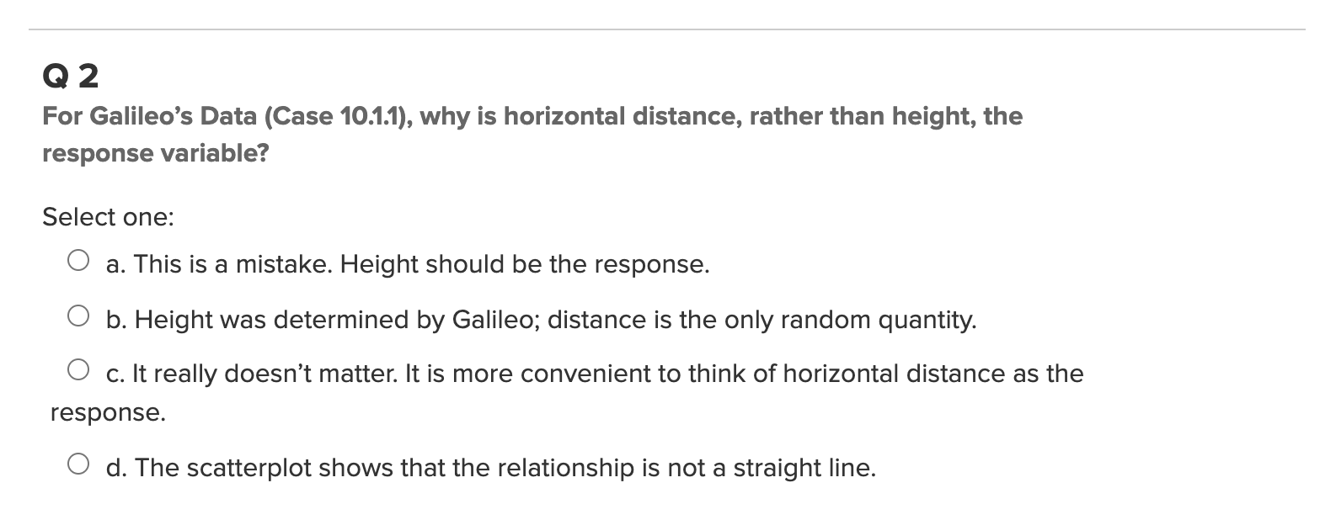
Option B

Slide 15
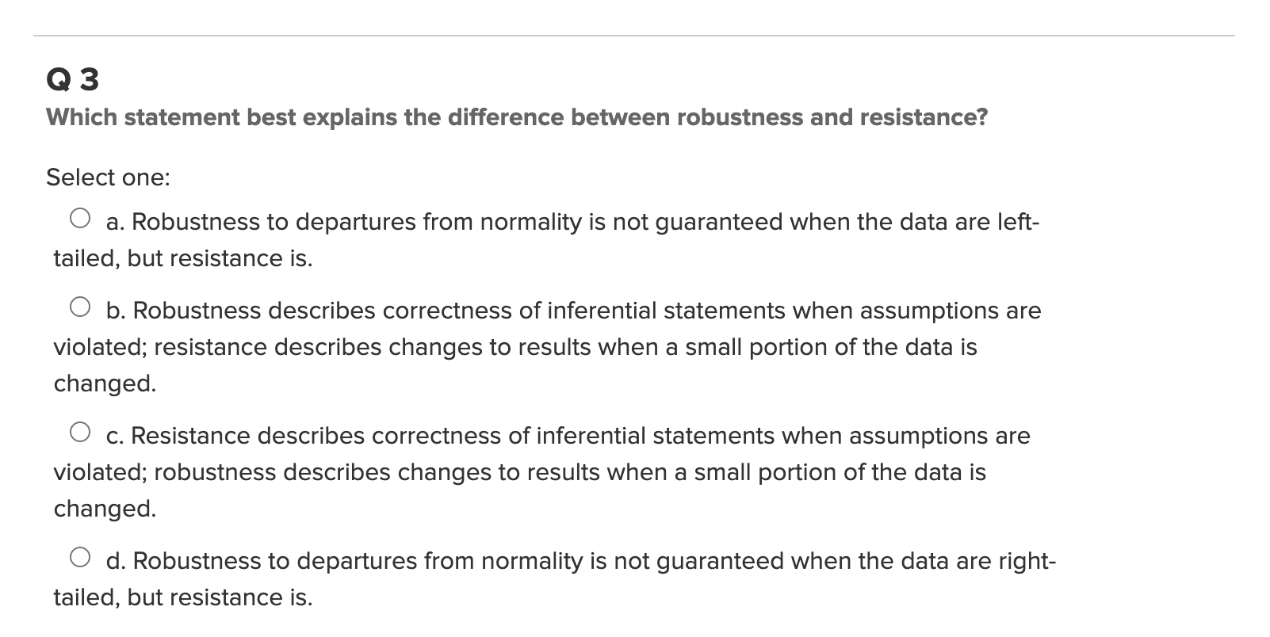
Option C

Slide 16
UNIT 12 QQQ

Slide 17
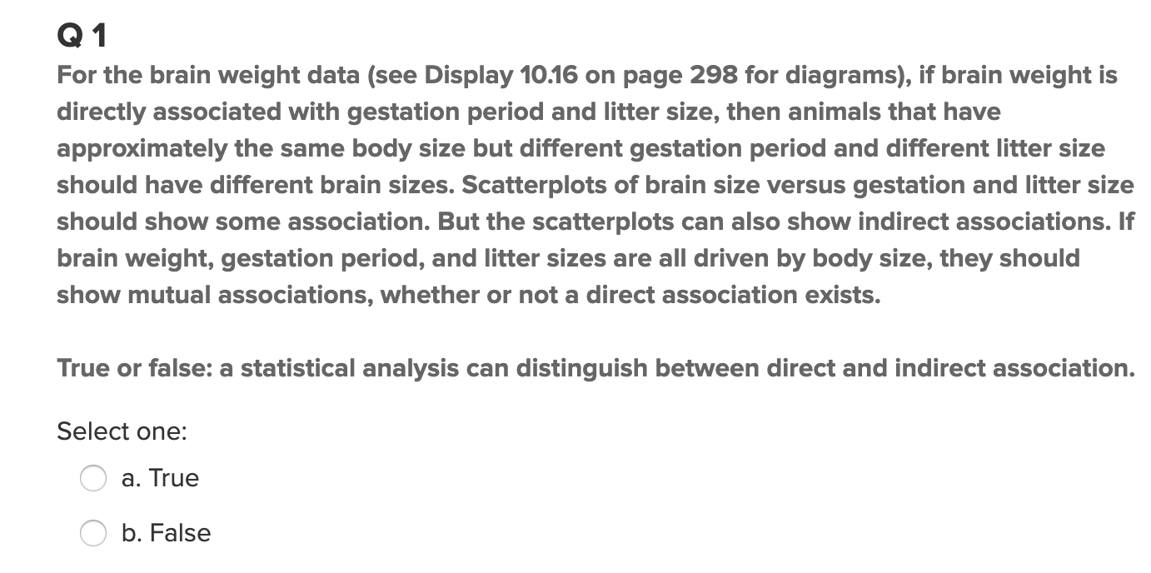
Option

Slide 18
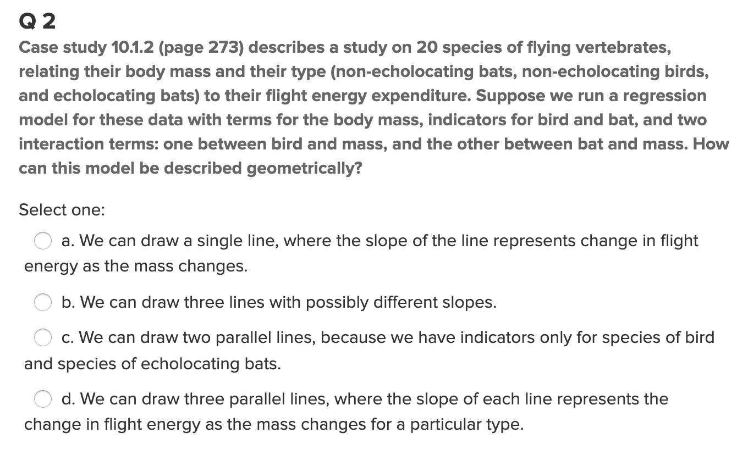
Option A

Slide 19
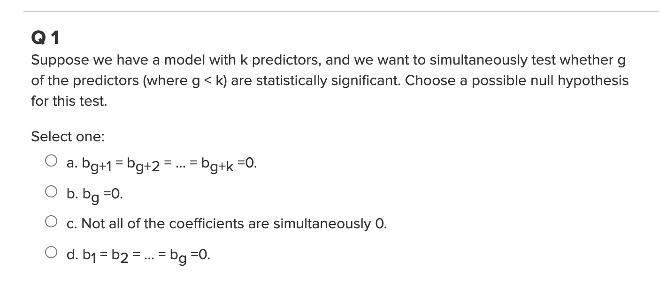
Option D

Slide 20
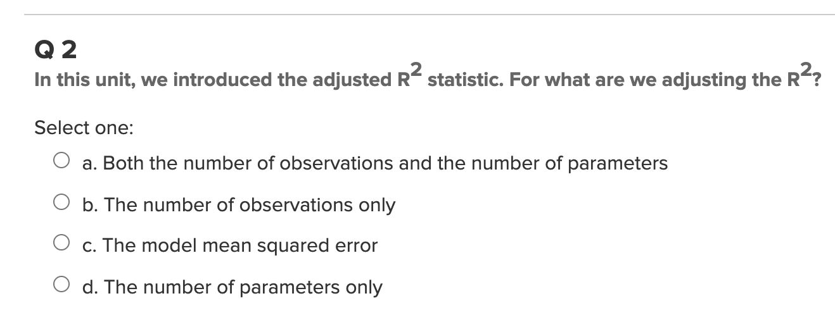
Option A

Slide 21
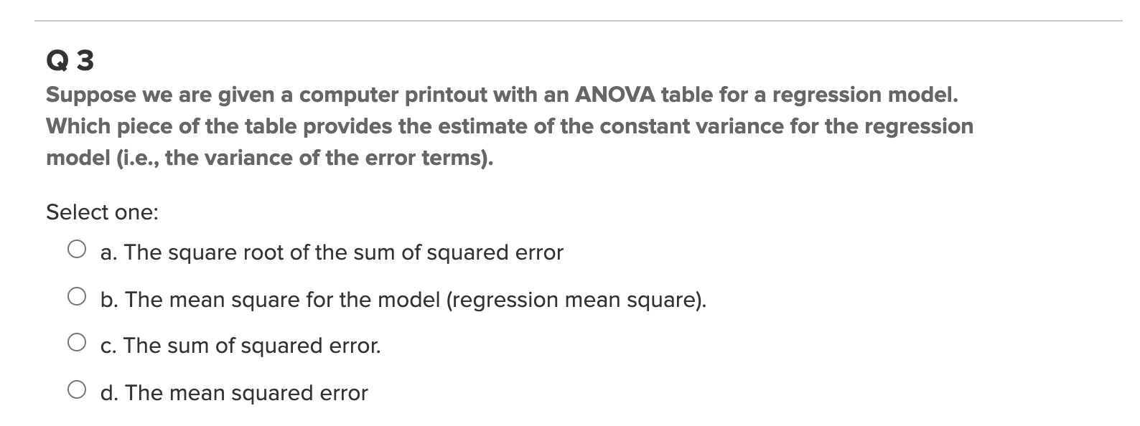
Option D

Slide 22
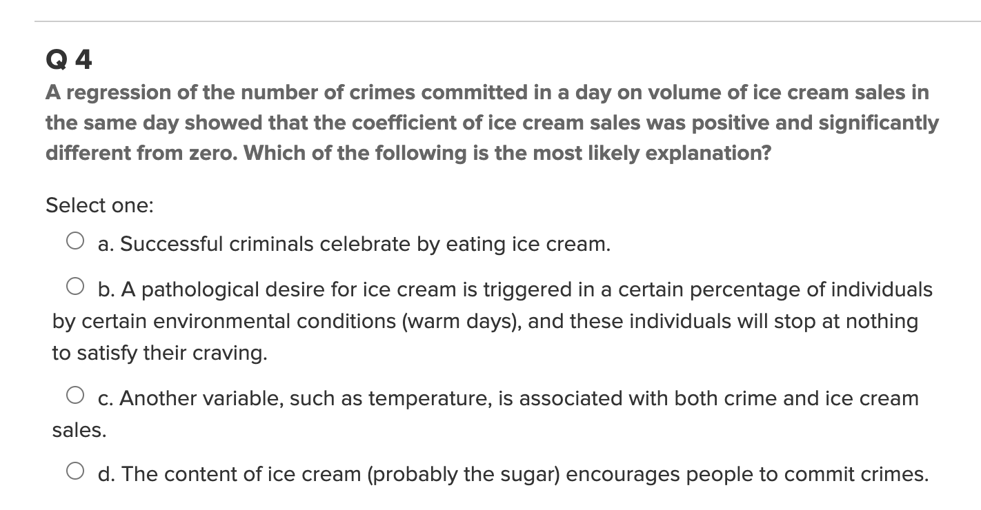
Option C

Slide 23
UNIT 14 QQQ

Slide 24
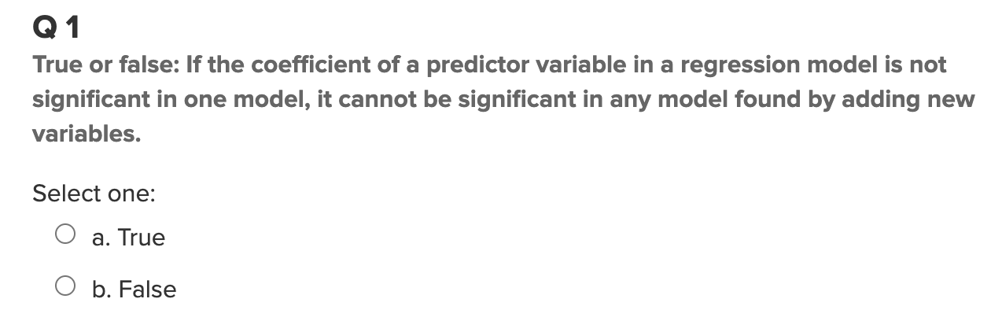
Option false

Slide 25
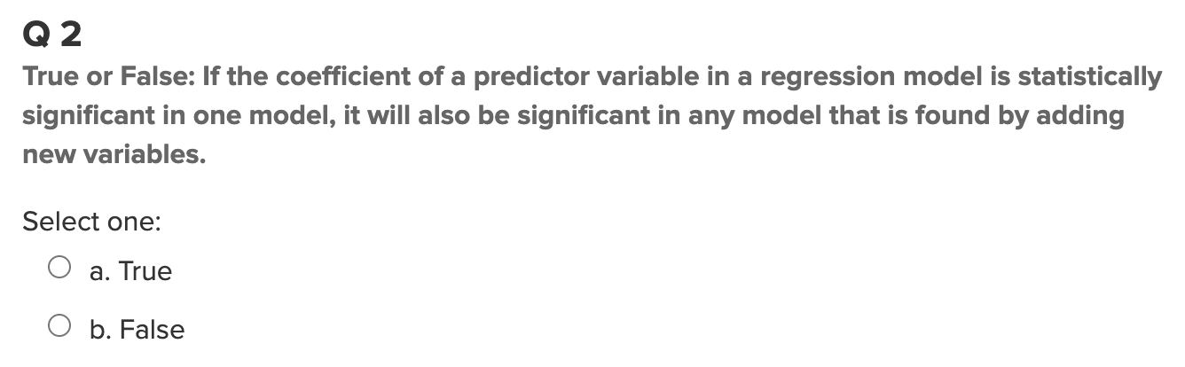
Option false

Slide 26
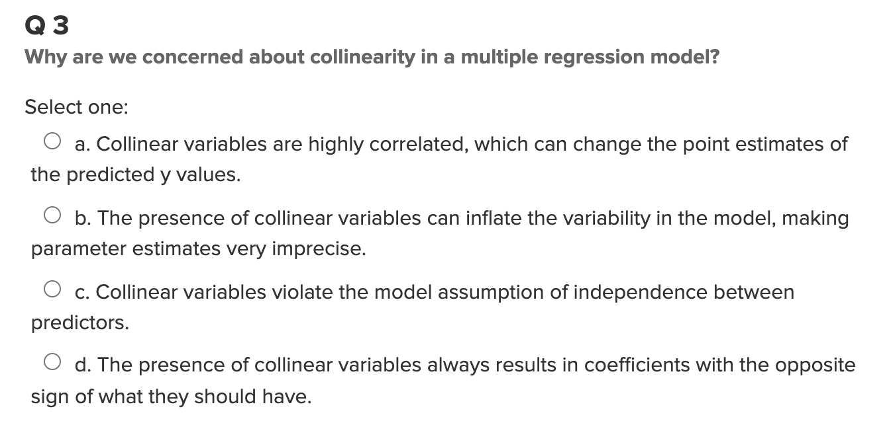
Option D

Slide 27
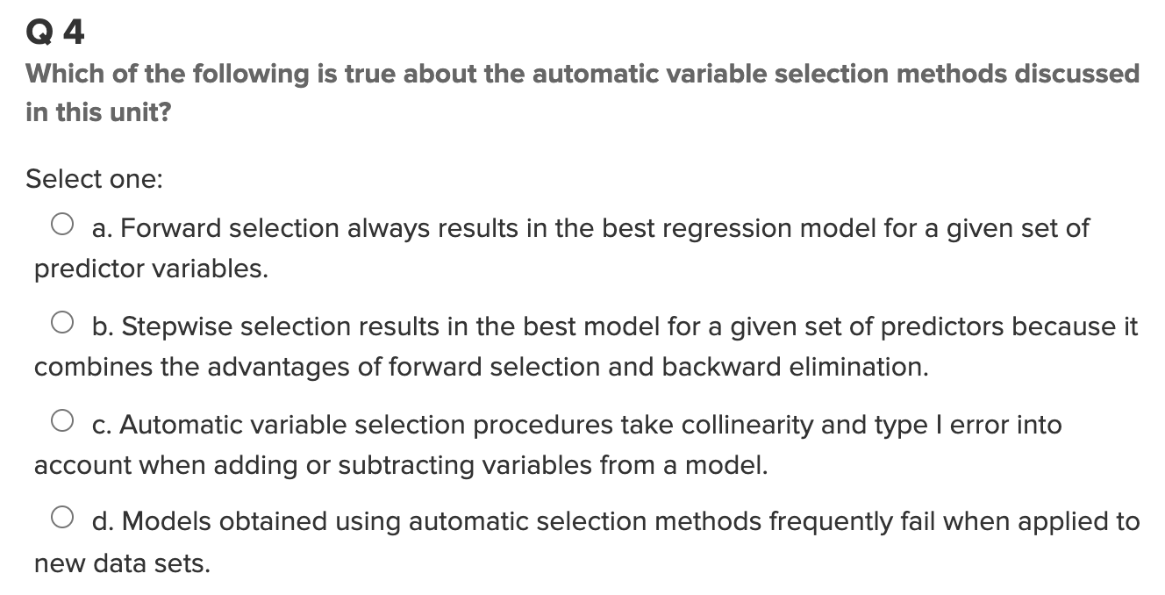
Option C

